Slide 1




Introduction to SharePoint
.ASCX
ASP.NET Web Forms
Telerik Software Academy
http://academy.telerik.com

Slide 2
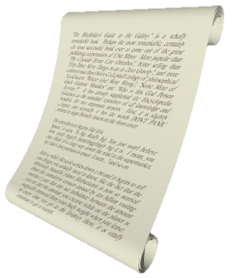

Table of Contents
What is SharePoint?
Basic concepts and structure
Sites
Lists and Document Libraries
Web-parts
Pages
Search
SharePoint editions
SPServices

Slide 3
What is SharePoint?
SharePoint is a web application framework and platform developed by Microsoft.
First launched in 2001
Built upon the ASP.Net framework
Additional layer of services and codebase
Integrates:
Intranet
content management and document management
According to Microsoft, SharePoint is used by 78% of Fortune 500 companies.

Slide 4

SharePoint Editions
Microsoft SharePoint Foundation
Underlying technology for all SharePoint sites
Free on-premises deployment
But requires Microsoft Windows Server
Microsoft Search Server Express
Microsoft SharePoint Enterprise
Office 365 - SharePoint Online
Cloud-based service, hosted by Microsoft

Slide 5
The SharePoint Wheel
Sites
Audience targeting, governance tools, Secure store service, web analytics functionality
Communities
'MySites' (personal profiles including skills management, and search tools), enterprise wikis, organization hierarchy browser, tags and notes
Content
Improved tooling and compliance for document & record management, managed metadata, word automation services, content type management

Slide 6
The SharePoint Wheel (2)
Search
Better search results, search customization abilities, mobile search, 'Did you mean?', OS search integration, Faceted Search, and metadata/relevancy/date/location based refinement options
Insights
Information from any part of the organization can be surfaced inside useful contexts, providing information that can improve effectiveness.
Composites
Pre-built workflow templates, BCS profile pages

Slide 7

Common Uses
The most common uses of SharePoint
Intranet portals
Enterprise content and document management
Extranet portal
Internet sites
Software framework

Slide 8
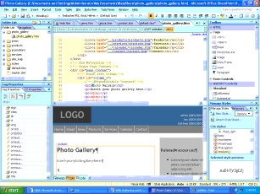
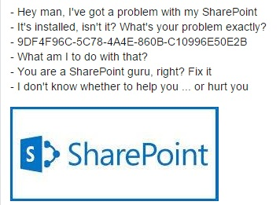
Configuration and customization
Web-based configuration
Manipulate content
Manage user permissions
Manage definitions and properties
SharePoint Designer
The 'Client Object Model‘ (CSOM)
'Sand-boxed' solutions
In multi-tenant cloud environments, these are the only customizations that are typically allowed.
Farm solutions

Slide 9
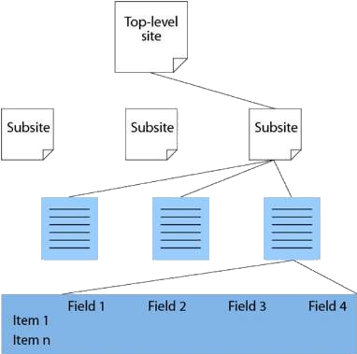

Sites
Sites and Site Collections
SP Site - collection of pages, site templates, lists, and libraries
A site may contain sub-sites, and those sites may contain further sub-sites
MySite
personal site for each user

Slide 10


Lists and Libraries
Lists
Workflows
Item-level or list-level permission
Version history tracking
Multiple content-types
External data sources
Library
list where each item in the list refers to a file
Content-type

Slide 11
Web-parts
Typical use:
Displaying content defined in the web-part's settings
Displaying items from Lists/Libraries
Providing access to features in the SharePoint platform
Providing a user interface into other products
Web-parts also support connections to other web-parts on the page
Web-parts based on completely custom code can be built in Microsoft Visual Studio 2010.

Slide 12
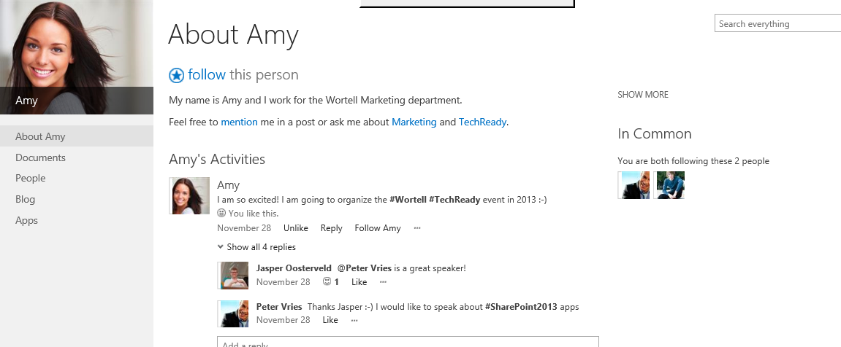
Pages and Search
Page content-types:
Wiki page
Web-part page
Publishing page
Microsoft produces a free product called Microsoft Search Server Express

Slide 13
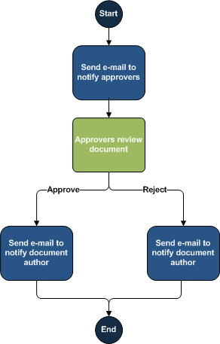
Workflows
Workflow - automated movement of documents or items through a sequence of actions or tasks that are related to a business process
Approval
Collect Feedback
Collect Signatures
Disposition Approval
Three-state
Group Approval
Translation Management

Slide 14

SPServices
Project Description
SPServices is a jQuery library which abstracts SharePoint's Web Services and makes them easier to use. It also includes functions which use the various Web Service operations to provide more useful (and cool) capabilities. It works entirely client side and requires no server install.
http://spservices.codeplex.com/

Slide 15
SPServices
Example: Get List Items
$().SPServices({
operation: "GetListItems",
async: false,
listName: "Announcements",
CAMLViewFields: "<ViewFields><FieldRef Name='Title' /> </ViewFields>",
completefunc: function (xData, Status) { $(xData.responseXML).SPFilterNode("z:row").each(function() {
var liHtml = "<li>" + $(this).attr("ows_Title") + "</li>";
$("#tasksUL").append(liHtml);
});
}
});

Slide 16
ASP.NET User Controls
http://academy.telerik.com

Slide 17
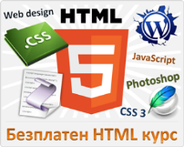


Free Trainings @ Telerik Academy
"Web Design with HTML 5, CSS 3 and JavaScript" course @ Telerik Academy
html5course.telerik.com
Telerik Software Academy
academy.telerik.com
Telerik Academy @ Facebook
facebook.com/TelerikAcademy
Telerik Software Academy Forums
forums.academy.telerik.com

